Slide 1
Patient-Physician Collaboration to Improve Rx Adherence
HCLS Hackathon
4.26.19

Slide 2
Driving Up Healthcare Costs
Chronic medications have adherence rates of ~50% and much lower for lifestyle drugs¹
Nonadherent patients demonstrate >3x increase in costs vs adherent patients²
Estimated expenses resulting from non-optimal medication therapy - $528 billion (2016)³
Meta-analysis of 771 studies found improved outcomes & decreases in costs when adherent⁴
So how can we improve patient adherence rates?
¹ “Helping patients follow prescribed treatment: clinical applications”, RB Haynes, https://www.ncbi.nlm.nih.gov/pubmed/12472330
² “Longitudinal Patterns of Medication Nonadherence and Associated Health Care Costs”, KA Hommel, https://www.ncbi.nlm.nih.gov/pubmed/28617754
³ “Cost of Prescription Drug related morbidity and mortality”, JH Watanabe, https://www.ncbi.nlm.nih.gov/pubmed/29577766
⁴ “Medication adherence outcomes of 771 intervention trials: Systematic review and meta-analysis”, VS Conn, https://www.ncbi.nlm.nih.gov/pubmed/28315760

Slide 3
Patient From Consumer to Participant
Rx Adherence’s differentiator is patient engagement - input and interaction
Platform encourages collaboration between providers and patients
Provider View allows physician to log new prescriptions & dosing protocols for patients
Patient View initiates interaction, encourages accountability, & tracks adherence
Patient Dashboard analyzes adherence metrics against prescriber protocols

Slide 4
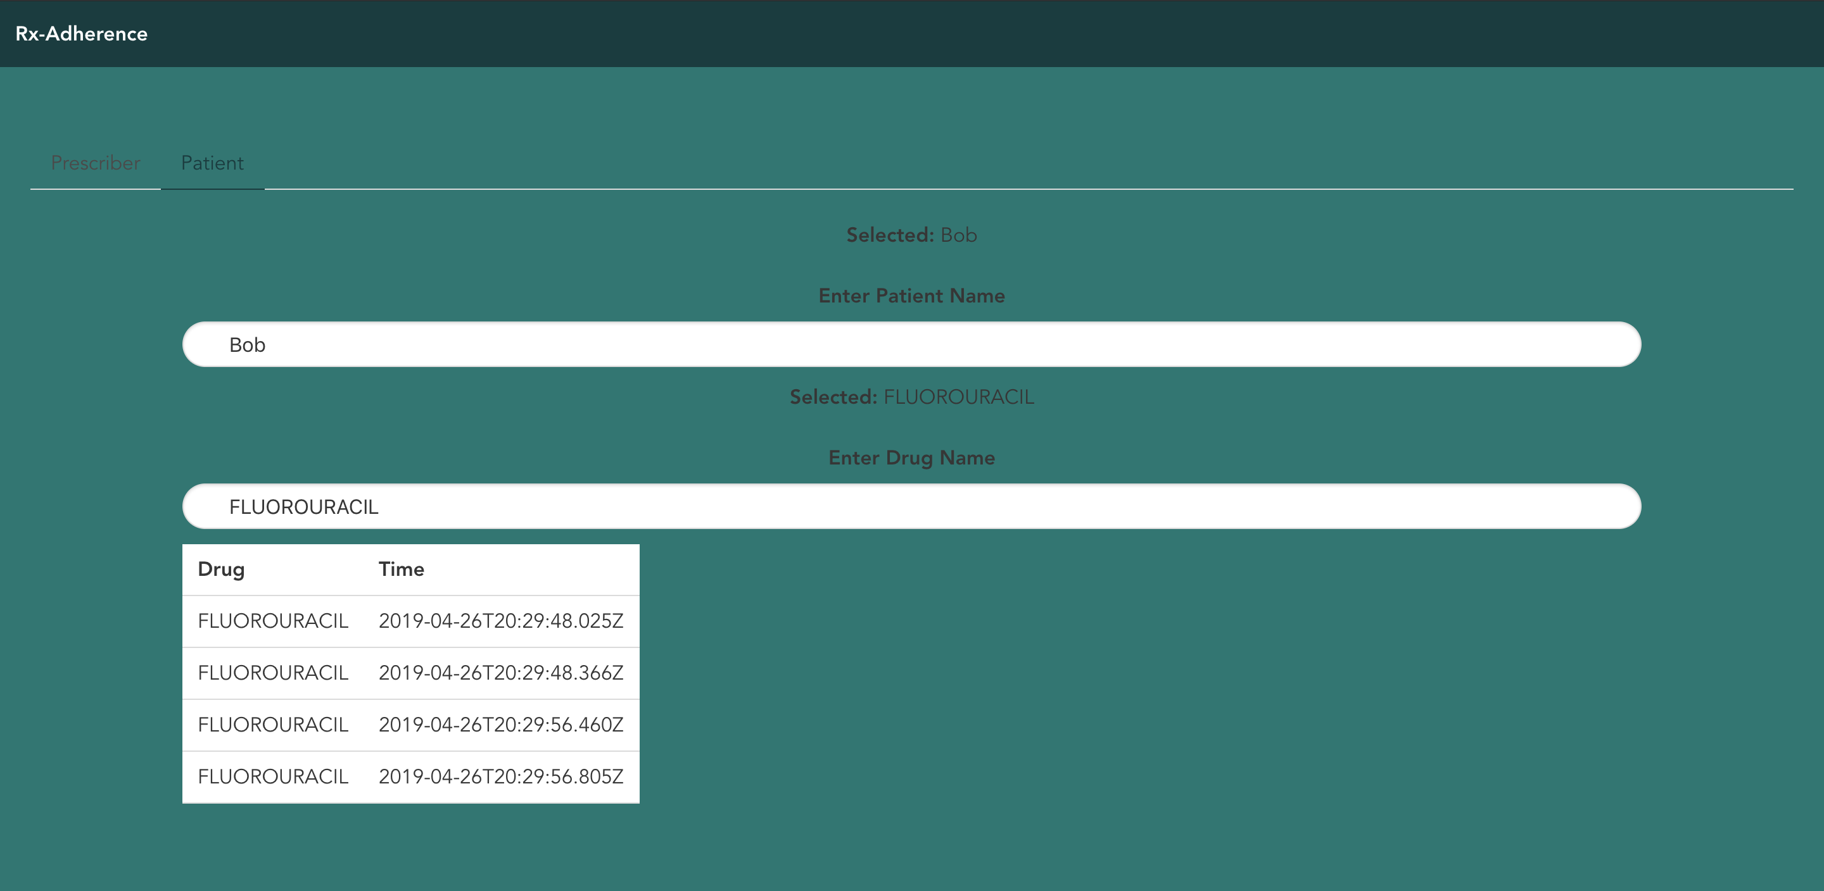
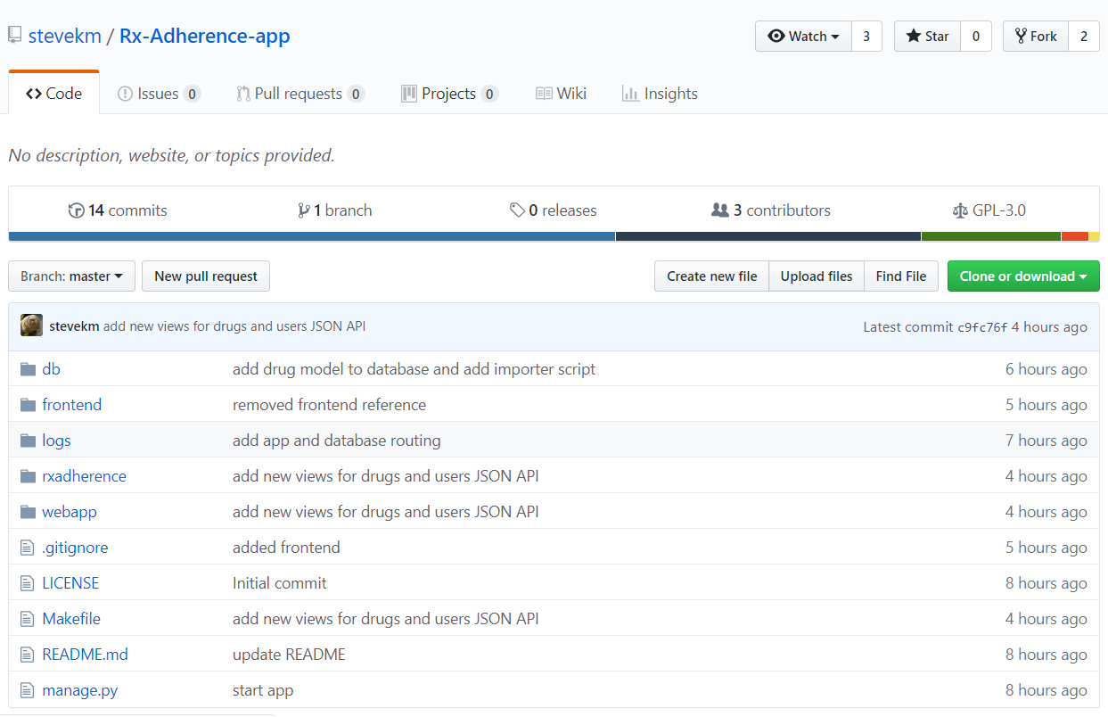
Rx Adherence UI & Github Page
https://github.com/stevekm/Rx-Adherence-app

Slide 5
Technology Stack Overview
API SERVER
FRONT END (GUI)
DATA STORE
Django
Dev: Local/VM
Prod: Google App Engine
JavaScript
Vue.js
Buefy
SQLite (POC)
Healthcare API
Transition to hosting on Google App Engine for cost and scalability optimization
Healthcare API will enhance security, enable de-identification, and leverage powerful tools

Slide 6
Technology Stack Interactions
PROVIDER VIEW
PATIENT VIEW
FRONT END (GUI)
1
Patient record created
3
Rx record created
X
Patient Log (JSON returned)
FRONT END (GUI)
2
Patient notification
3
Patient Logs adherence
API SERVER
API SERVER
DATA STORE
2
4
Y
DATA STORE
1
4
Log to DB
(JSON returned)
DB updated w/ new event
Updated w/ Patient input
Rx record logged by Provider
Updated w/ Patient input

Slide 7
Future Iterations & Enhancements
Rx bottle NFC scan to schedule refills, verify pick-ups, and log administration via mobile device
Healthcare API integration (BigQuery, ML) to analyze savings & demonstrate value to payers
Utilize DataLab to predict nonadherent patients requiring intervention
Incorporate list pricing, payer benefits, & POS discounts to cultivate a competitive market
Provides patient a portal to report potential adverse events

Slide 8
Benefits of Rx-Adherence
Improved adherence rates of ~80% for medications, a key measure of optimal therapeutic efficacy¹
Prevent financial waste due of non-optimal medication therapy ($528 billion - 2016)
Reduce the ~275k deaths per year attributable to non-optimal medication therapy²
Empower individuals to take ownership of their patient journey and improve health outcomes
¹ “Patient adherence and medical treatment outcomes: a meta-analysis. Med Care”, MR DiMatteo, https://www.ncbi.nlm.nih.gov/pubmed/12218770
² “Cost of Prescription Drug related morbidity and mortality”, JH Watanabe, https://www.ncbi.nlm.nih.gov/pubmed/29577766

Slide 9
Thank You
Questions?

